Slide 1
Gravitational Waves: Experimental Techniques
1
Gabriele Vajente
LIGO Laboratory – California Institute of Technology
TRISEP 2018 - Perimeter Institute

Slide 2
Outline
Lecture 1: the basics of interferometric detection of gravitational waves
Lecture 2: fundamental noise sources (seismic, thermal and quantum noises)
Lecture 3: the dirty reality of ”technical noises” (scattered light, control noise, etc…) and prospects for the future

Slide 3
Optical configurations to detect gravitational waves
Lecture 1

Slide 4
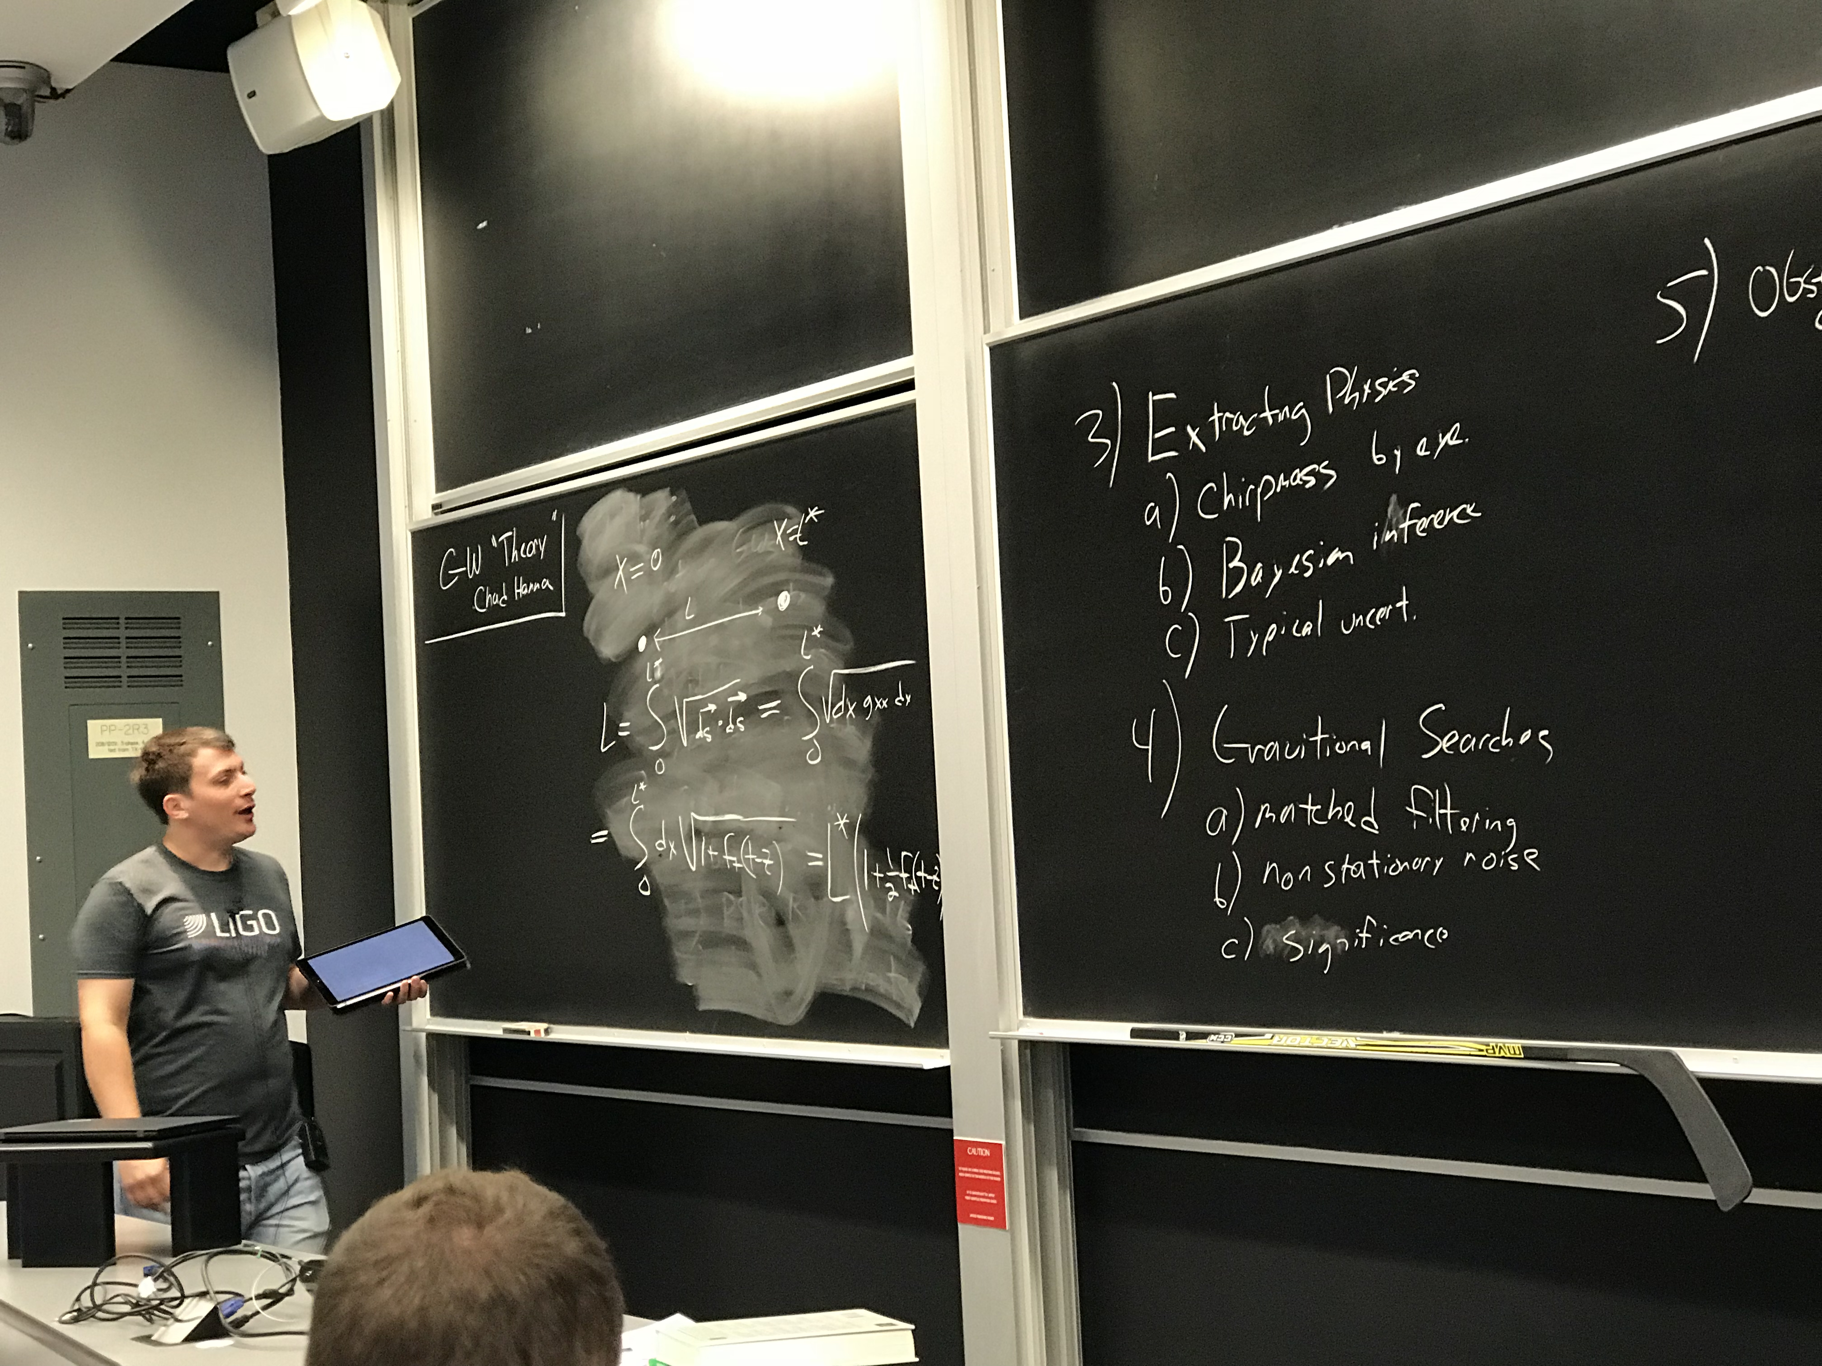
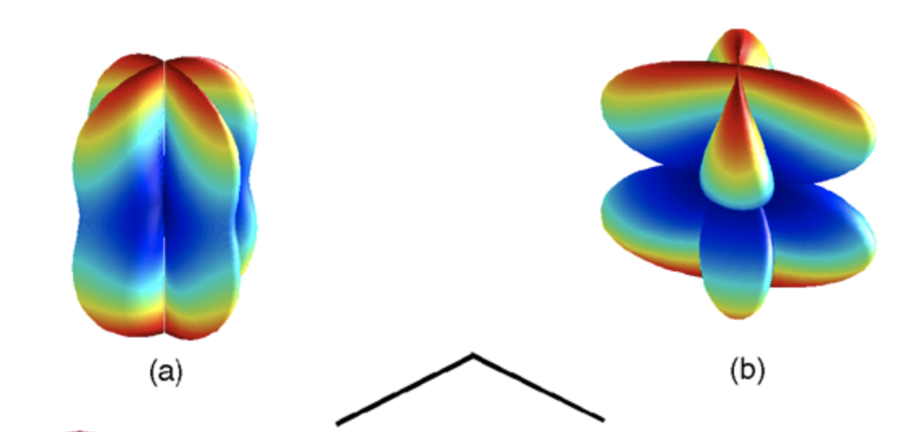
Gravitational waves
All we need to know for this lecture:
Change in the distance between mirrors
For km scale distances, and audio frequencies, flat response in frequency
Differential displacement along orthogonal arms
+
x

Slide 5
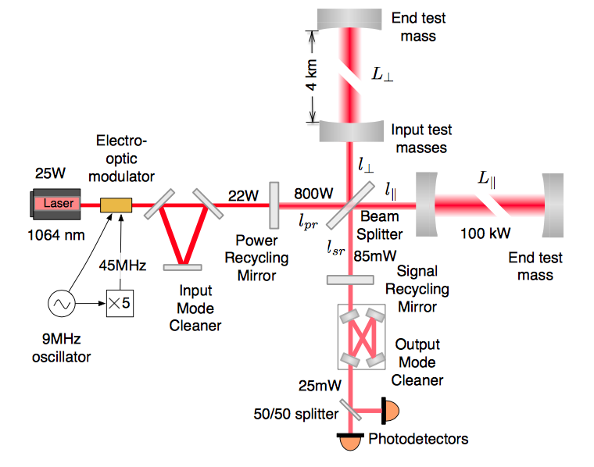
Interferometric detectors

Slide 6
Lasers
The Advanced LIGO Pre-Stabilized Laser
Monochromatic light source
Diffraction limited, but we can use a plane-wave approximation for most of the discussion

Slide 7
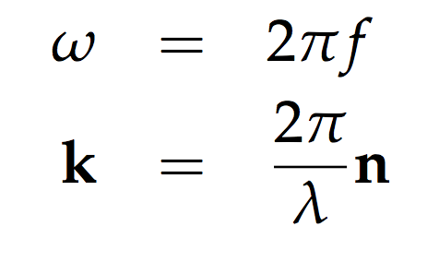
Lasers
The Advanced LIGO Pre-Stabilized Laser
Monochromatic light source
Diffraction limited, but we can use a plane-wave approximation for most of the discussion
LIGO laser power 70 W
Wavelength 1064 nm

Slide 8
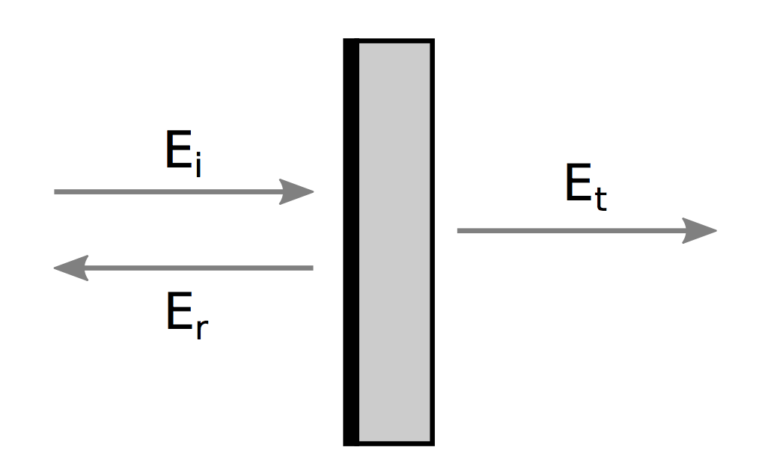
Mirrors
An Advanced LIGO mirror suspended in the vacuum chamber
Dielectric coatings
Very low absorption
High optical quality of both substrate and surface

Slide 9
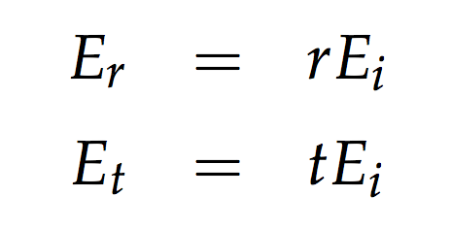
Mirrors
An Advanced LIGO mirror suspended in the vacuum chamber
Dielectric coatings
Very low absorption
High optical quality of both substrate and surface

Slide 10
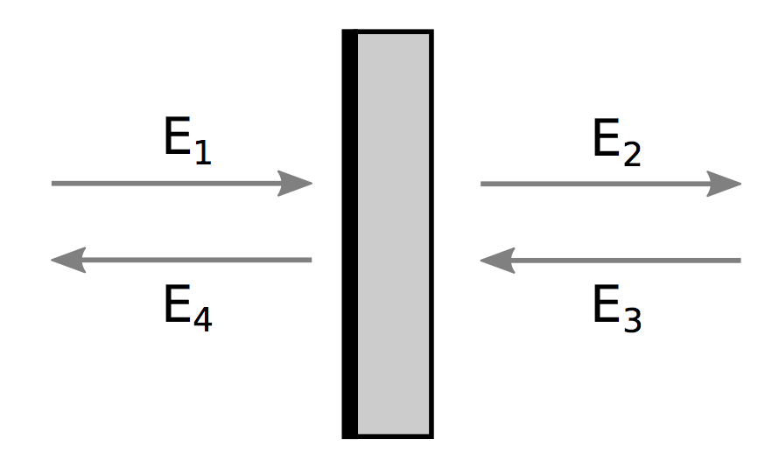
Mirrors
An Advanced LIGO mirror suspended in the vacuum chamber
Dielectric coatings
Very low absorption
High optical quality of both substrate and surface

Slide 11
Mirrors
An Advanced LIGO mirror suspended in the vacuum chamber
Dielectric coatings
Very low absorption
High optical quality of both substrate and surface

Slide 12
Photodetectors
The Advanced LIGO photodiode that detected the first GW
They can detect only the power
Output a current proportional to the impinging laser power
Instantaneous absolute phase of field not accessible

Slide 13
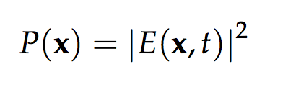
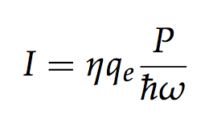
Photodetectors
The Advanced LIGO photodiode that detected the first GW
They can detect only the power
Output a current proportional to the impinging laser power
Instantaneous absolute phase of field not accessible

Slide 14
Michelson interferometer
The original Michelson and Morley experiment
Arguably the most sensitive instrument to detect differential strain
Based on interference of two laser beams propagating in orthogonal directions

Slide 15
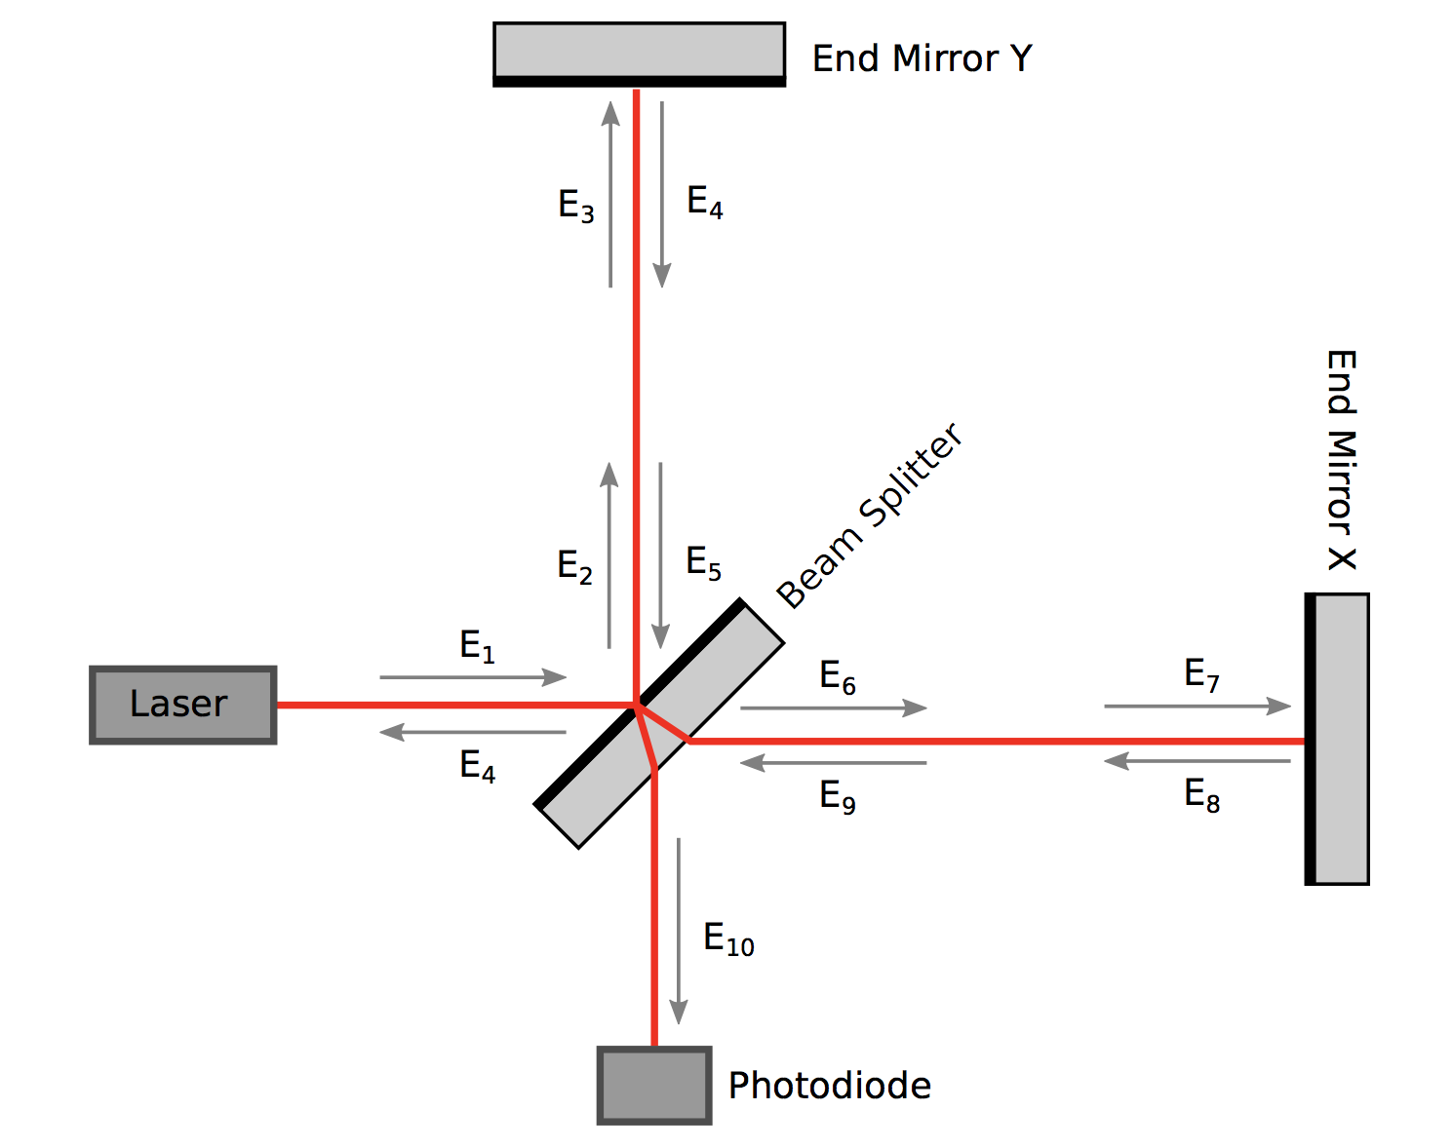
Michelson interferometer
The original Michelson and Morley experiment
Arguably the most sensitive instrument to detect differential strain
Based on interference of two laser beams propagating in orthogonal directions

Slide 16
Michelson interferometer

Slide 17
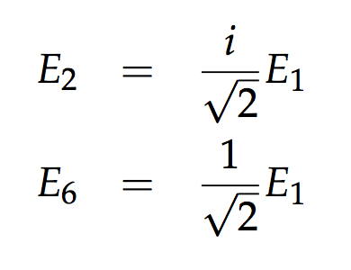
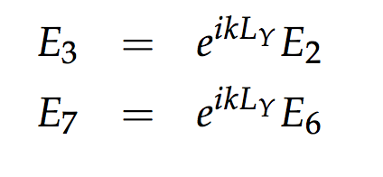
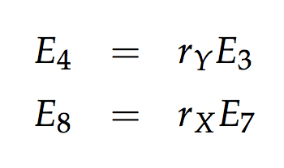
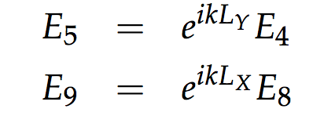
Michelson interferometer

Slide 18
Michelson interferometer

Slide 19
Michelson interferometer

Slide 20
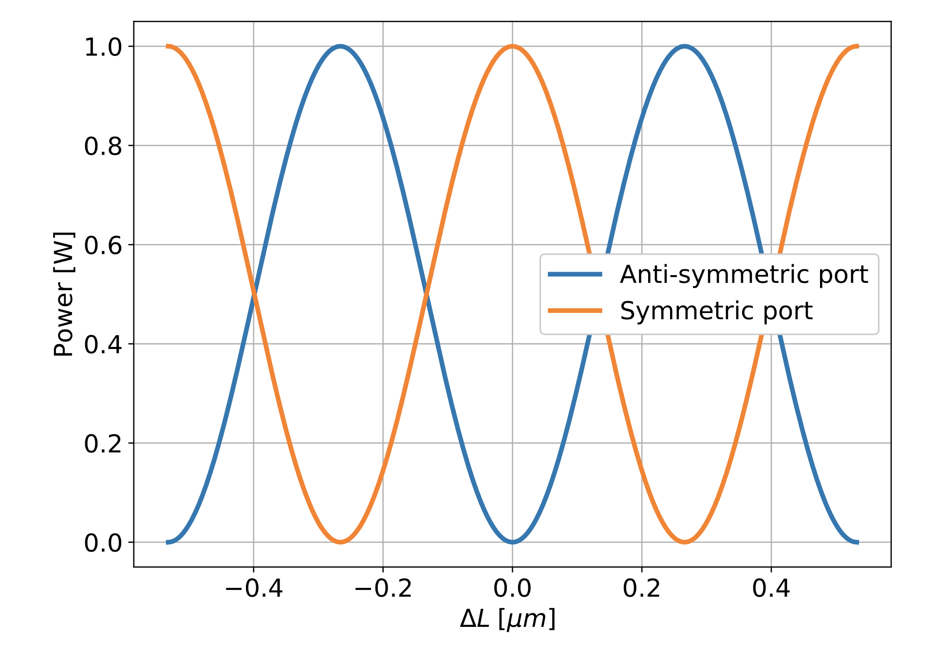
Michelson Interferometer

Slide 21
Response to GW signals
We detect the power at the anti-symmetric port

Slide 22
Response to GW signals
We detect the power at the anti-symmetric port

Slide 23
Response to GW signals
We detect the power at the anti-symmetric port

Slide 24
Response to GW signals
We detect the power at the anti-symmetric port

Slide 25
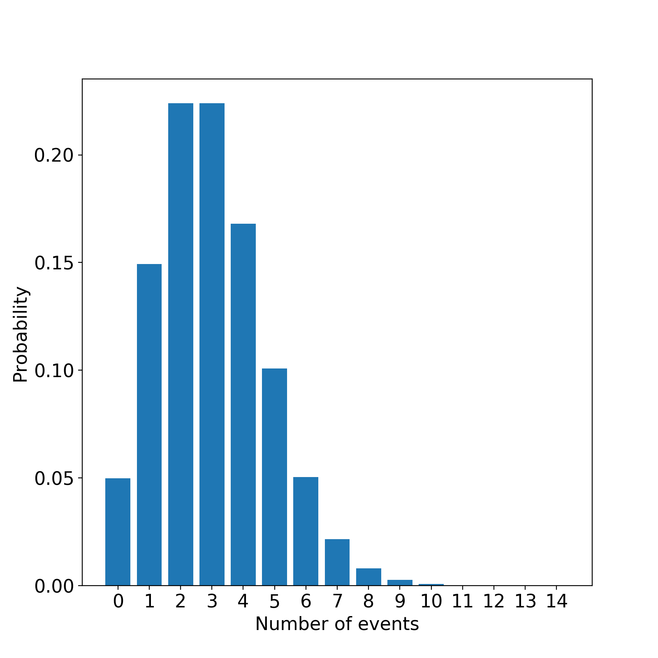
Shot noise
The Poisson distribution for an average number of events equal to 3
Light is quantized
Power is proportional to the number of photons
Uncorrelated events: Poisson’s distribution

Slide 26
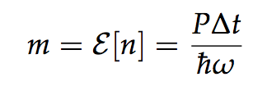
Shot noise
The Poisson distribution for an average number of events equal to 3
Light is quantized
Power is proportional to the number of photons
Uncorrelated events: Poisson’s distribution

Slide 27
Signal to noise ratio
Power at AS port:
Optical gain:

Slide 28
Signal to noise ratio
Power at AS port:
Optical gain:

Slide 29
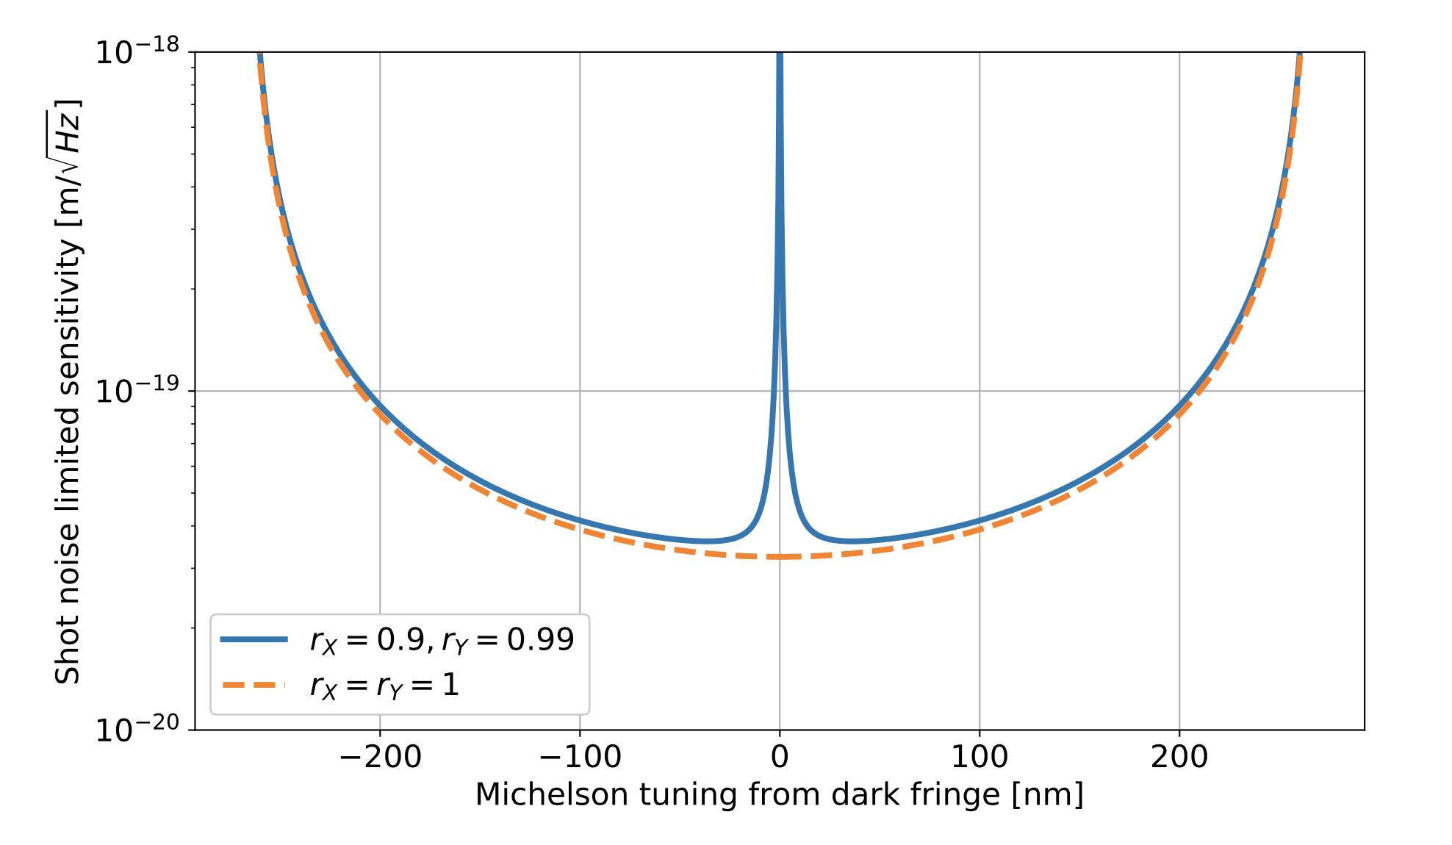
Signal to noise ratio

Slide 30
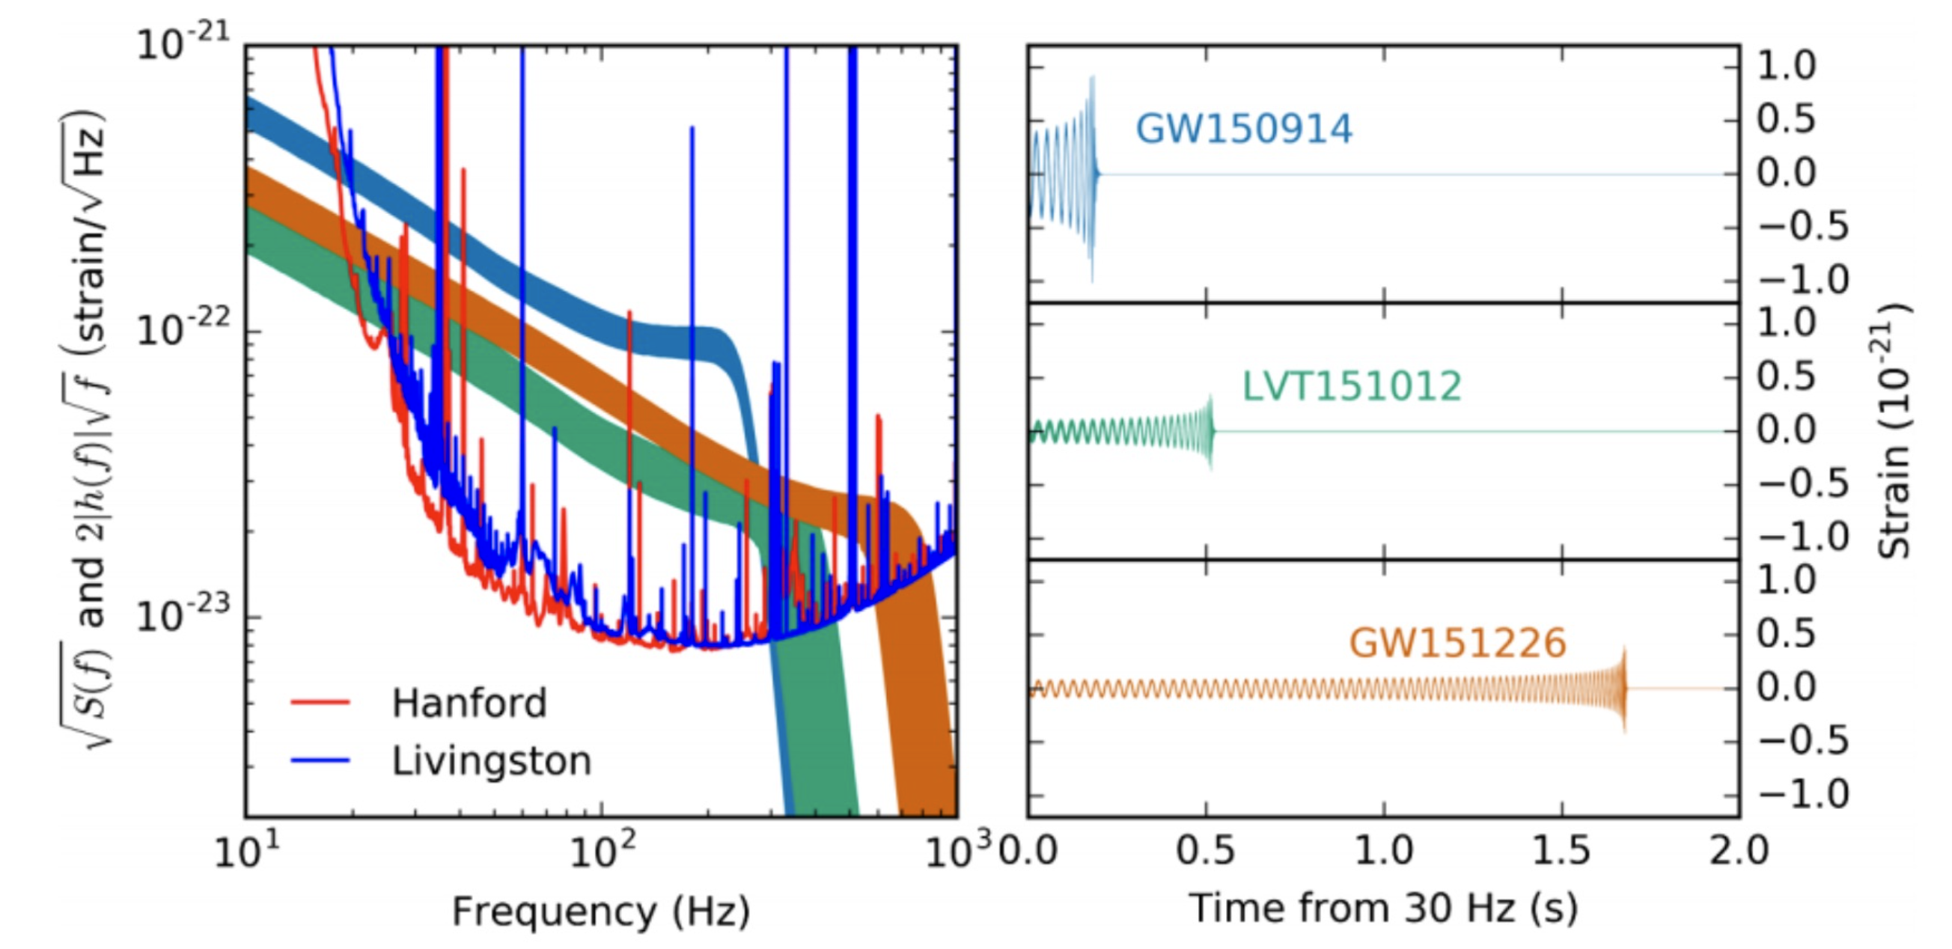
How to improve the sensitivity?

Slide 31
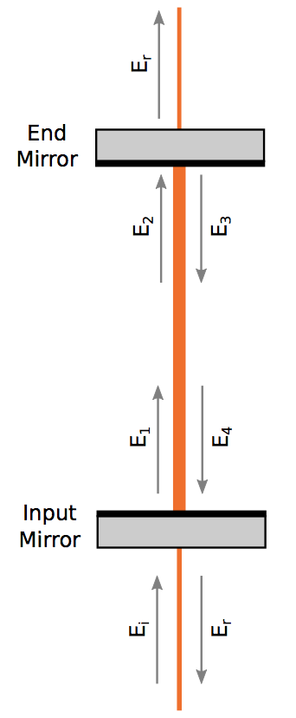
Fabry-Perot resonant cavities

Slide 32
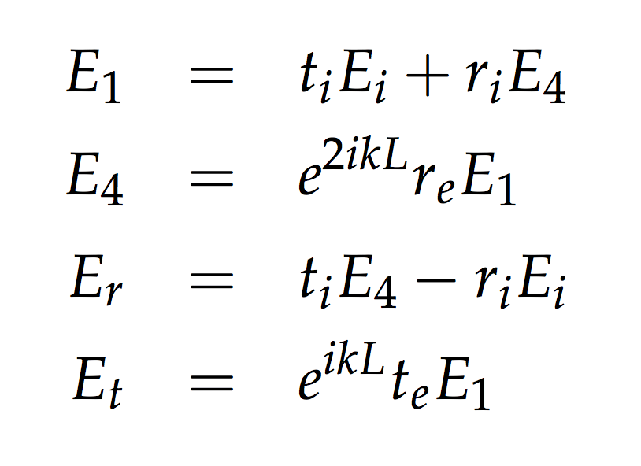
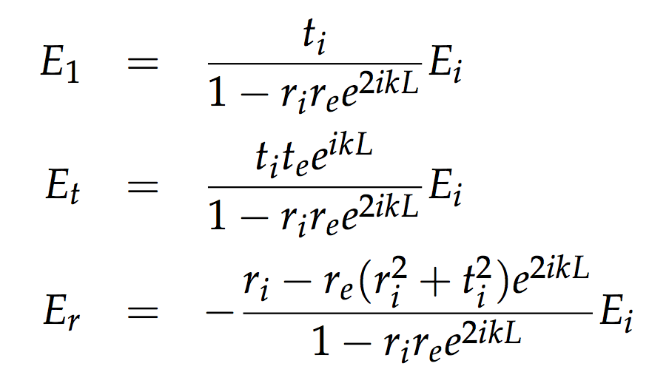
Fabry-Perot resonant cavities

Slide 33
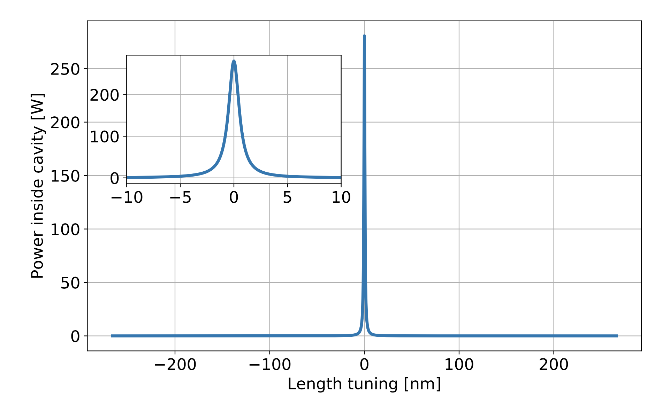
Fabry-Perot resonant cavities

Slide 34
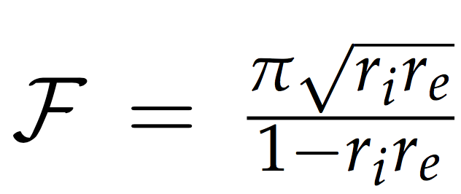
Fabry-Perot resonant cavities

Slide 35
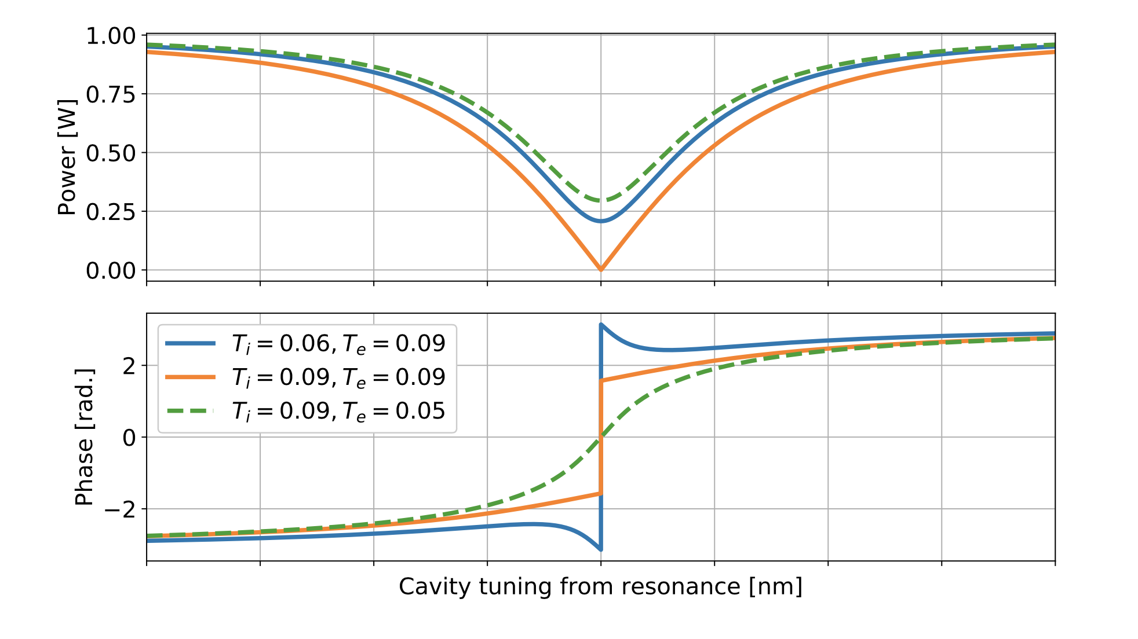
Fabry-Perot resonant cavities

Slide 36
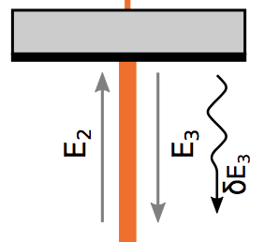
Frequency response

Slide 37
Frequency response

Slide 38
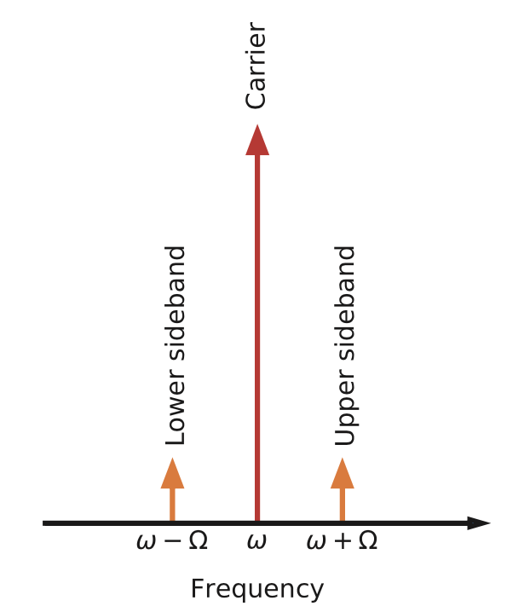
Frequency response

Slide 39
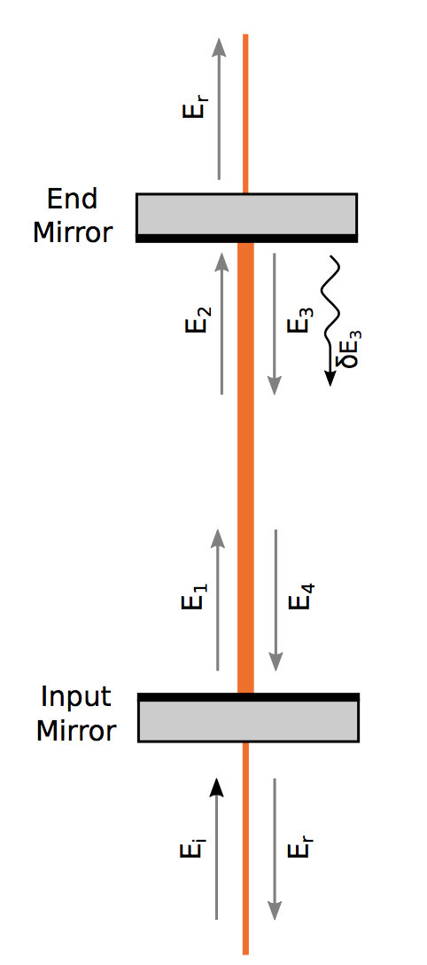
Frequency response

Slide 40
Frequency response

Slide 41
Cavity pole

Slide 42
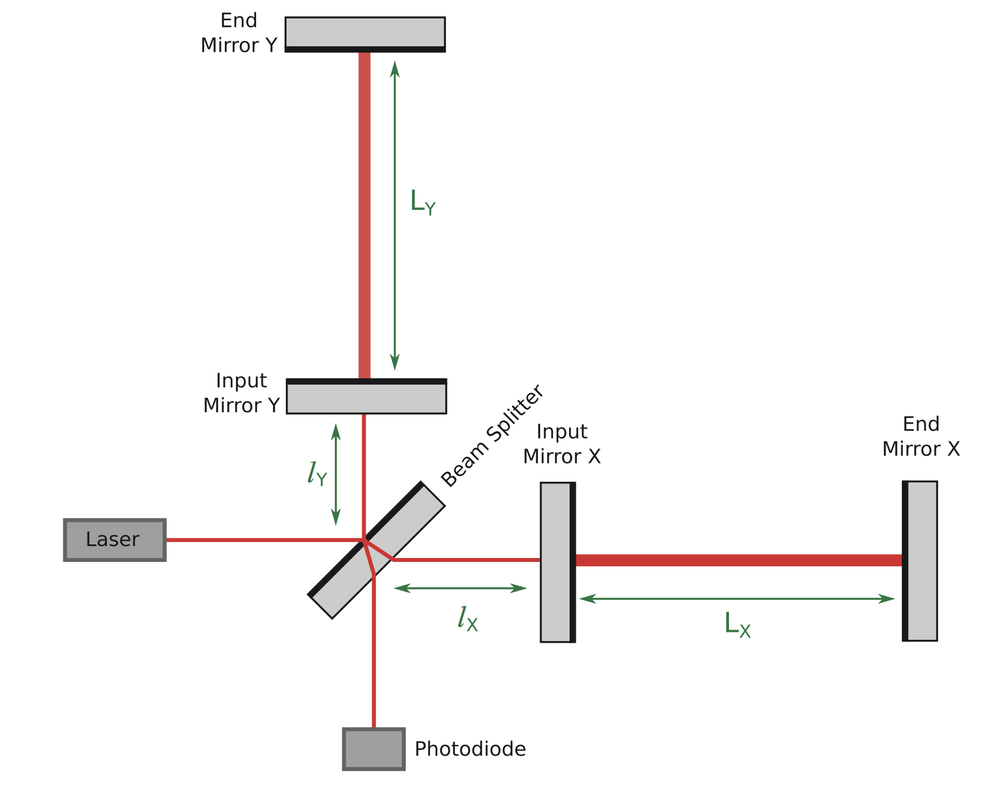
Fabry-Perot Michelson

Slide 43
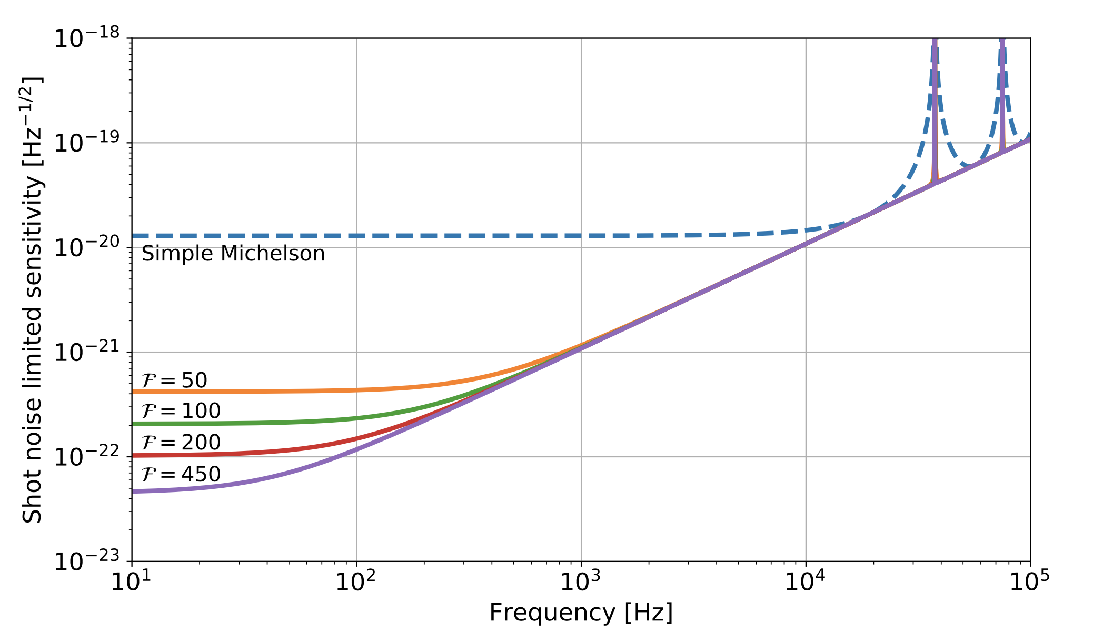
Fabry-Perot Michelson

Slide 44
Power recycling

Slide 45
Power recycling

Slide 46
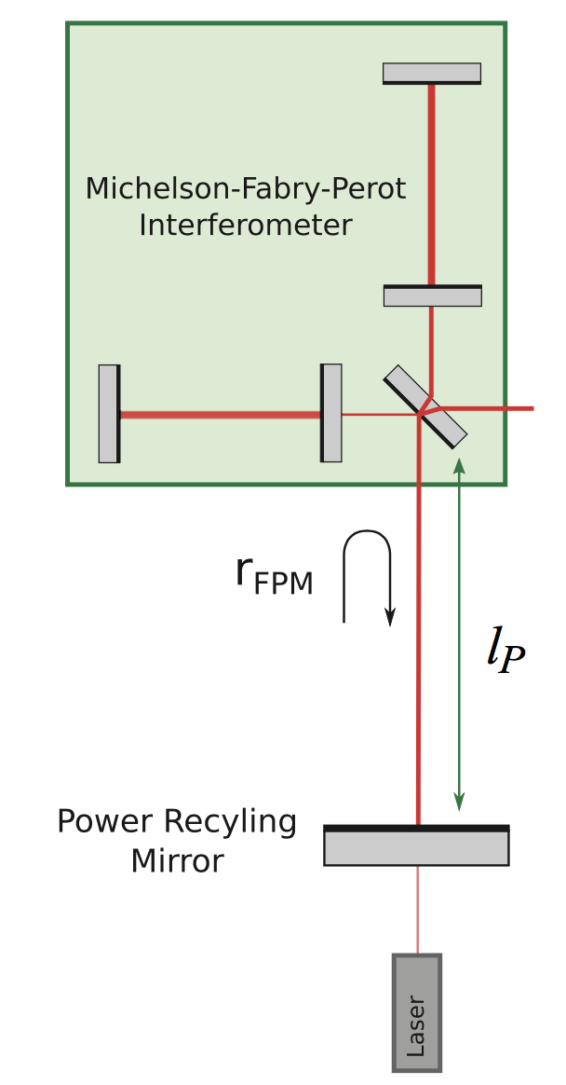
Power recycling

Slide 47
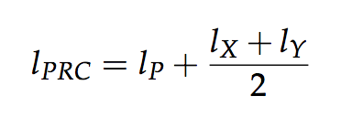
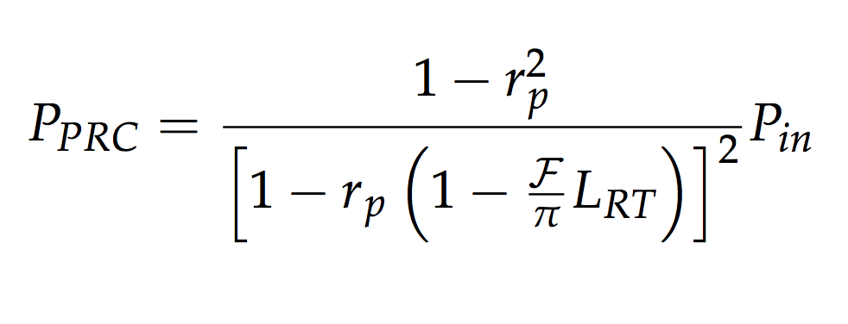
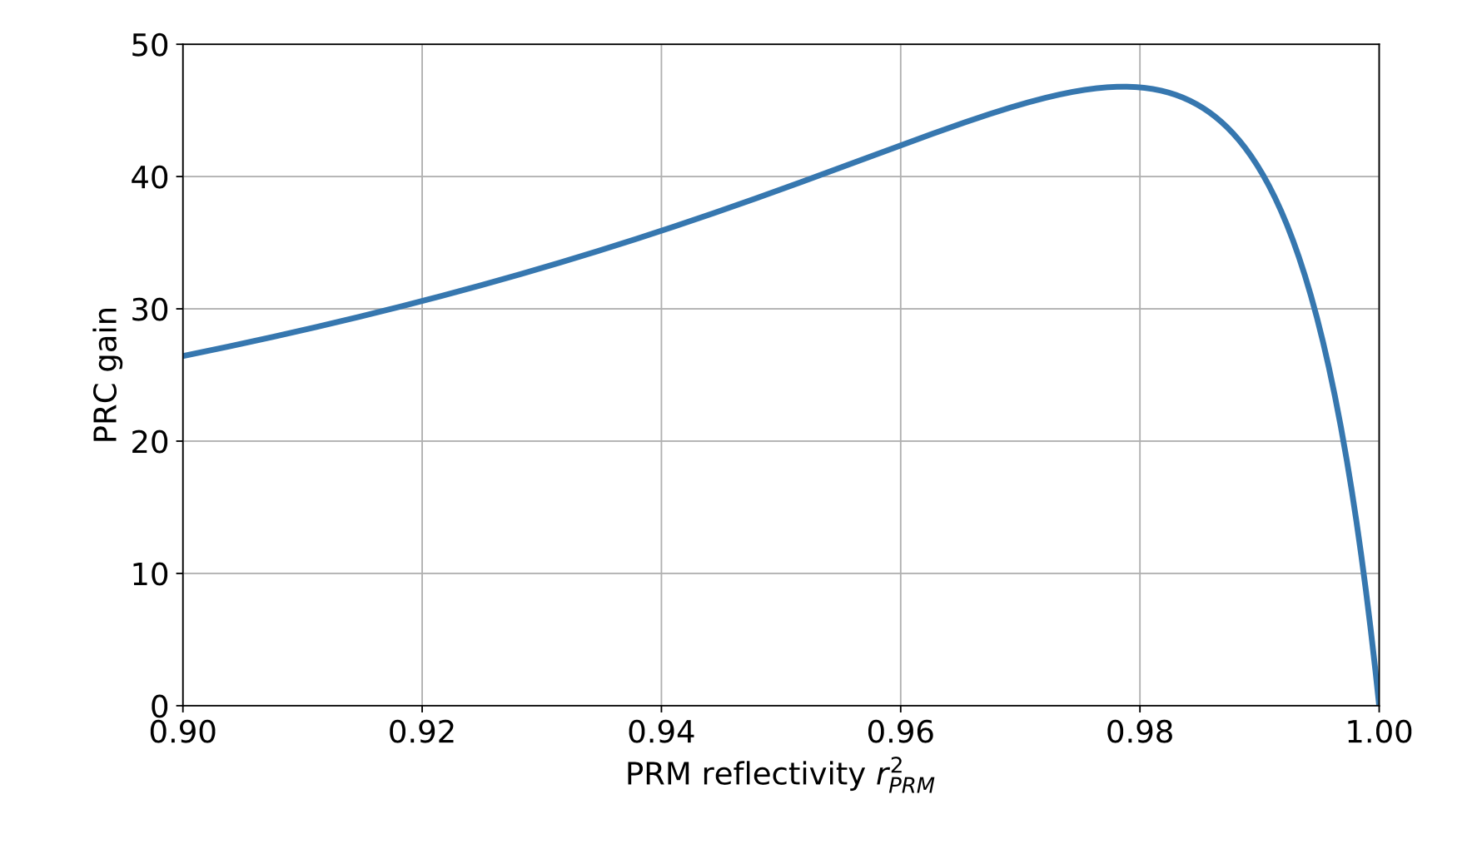
Power recycling

Slide 48
Power Recycling

Slide 49
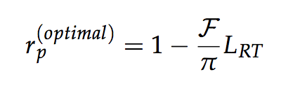
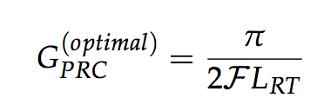
Power Recycling

Slide 50
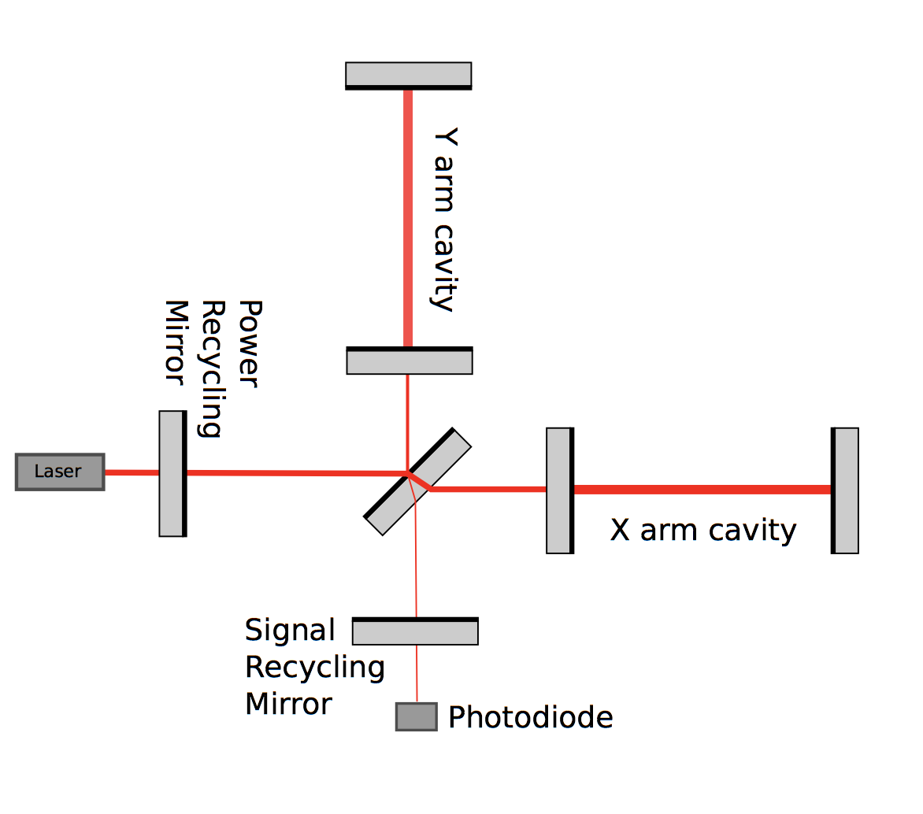
Signal recycling

Slide 51
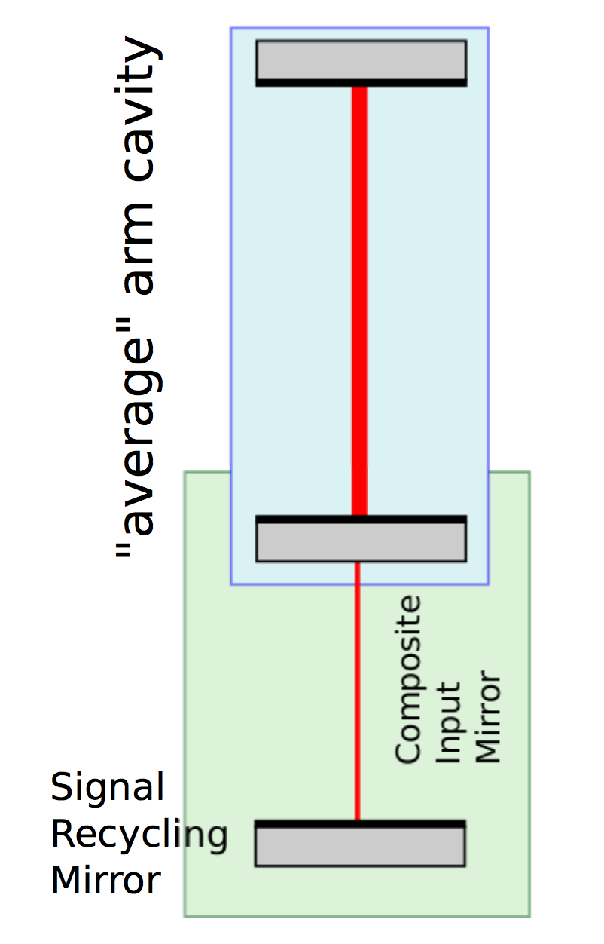
Signal recycling

Slide 52
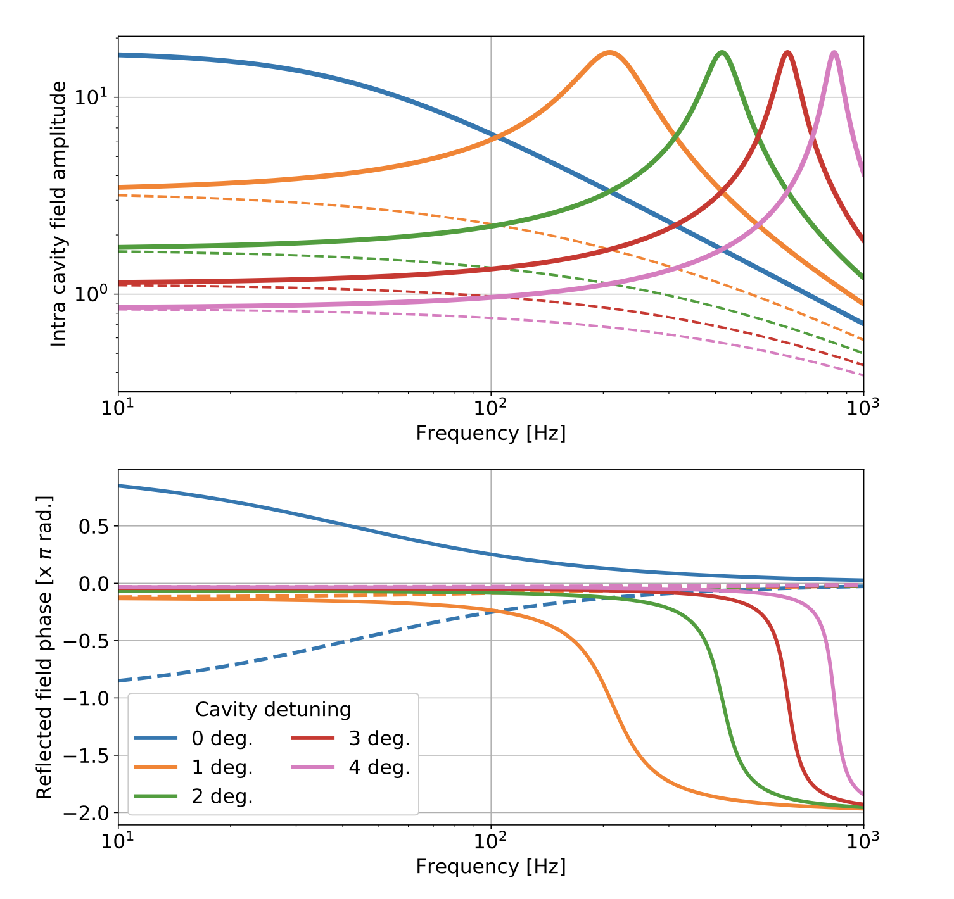
Detuned cavity

Slide 53
Signal recycling

Slide 54
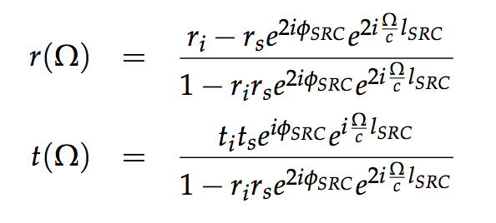
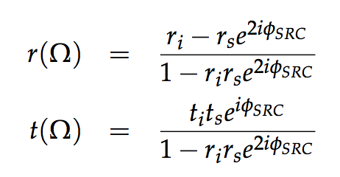
Signal recycling

Slide 55
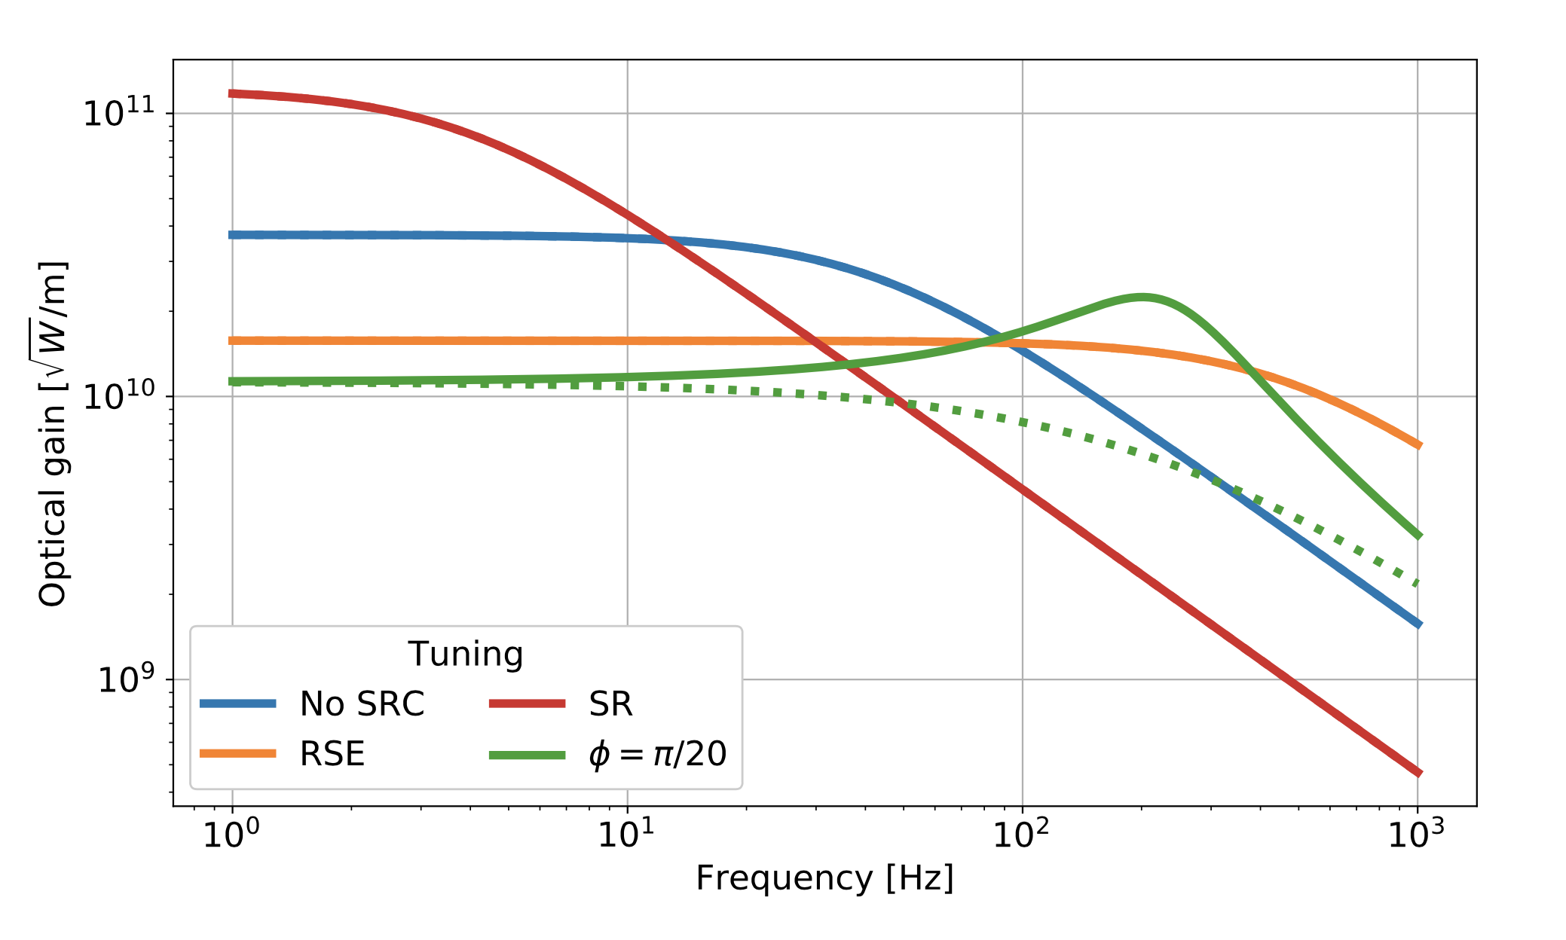
Signal recycling

Slide 56
Signal recycling

Slide 57
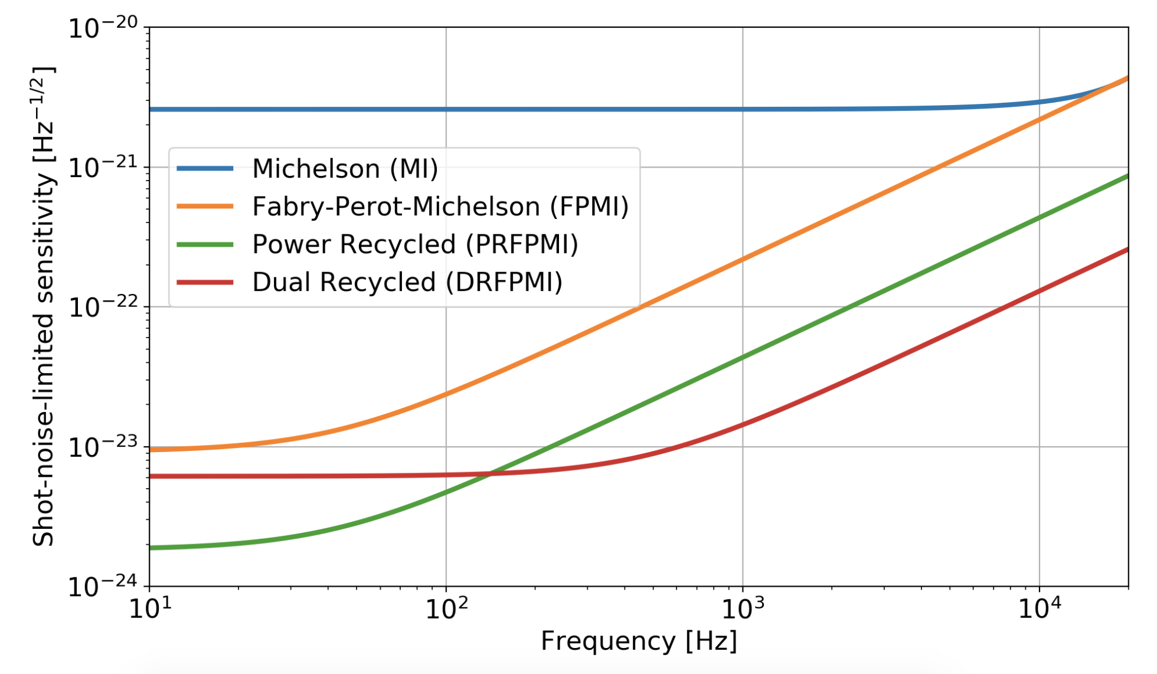
Summary

Slide 58
Advanced LIGO design

Slide 59
Next time
Let’s get a bit more realistic: fundamental noise sources
Quantum noise and squeezing
Thermal noise and coatings
Seismic noise
Gabriele Vajente
LIGO Laboratory California Institute of Technology
1200 E. California Blvd.
Pasadena (CA) 91125 – USA
vajente@caltech.edu

